Slide 1



Tumut Market Update
2nd Half 2026
In Q2 2026, Tumut* recorded a median house price of $450,000 and a median land price of $125,000. This is a slight price softening of -1.1% in the past 12 months (Q2 2025 – Q2 2026) for houses, which is reflective of the current higher interest rate environment. That said, house sales increased by 5.6% sales (to 57 sales in Q2 2026), suggesting buyer demand remain high. Vacant land prices have decreased -25.0% to $125,000 into Q2 2026, however the vacant land market is extremely small at only 6 sales in Q2 2026. A slightly more affordable house price suggest that now is an ideal time for first home buyers to enter the market; especially as there is only a small number of new houses in the construction pipeline.
Tumut will see approximately $560.8M of new projects due to commence construction between 2024 and 2027.
The significant influx of infrastructure developments set to commence in Tumut will stimulate economic growth through local job creation in the construction process and improve liveability for residents in the long run.
This in turn can attract more people to live in Tumut, which will have a spill over effect of increasing housing demand.
There only two residential projects due to commence construction between 2024 and 2027, which are
140 Lambie Street Units (3 Units)
Lot 9 Fitzroy Street Dwellings (6 Dwellings)
The incoming residential stock will not be enough, compared to the 57 house sales in Q2 2026. Therefore, Tumut will be undersupplied, which will lead to more price growth, for all property types (not just houses).
MEDIAN PRICE
Q2 2026
AVERAGE DAYS
ON MARKET Q2 2026
115
193
$450K
$125K
HOUSE
LAND
MEDIAN PRICE
Q2 2026
AVERAGE DAYS
ON MARKET Q2 2026
27
24
6
$465
$332
HOUSE
UNIT
3 Units/ Apartments
Dwellings

Slide 2

Average vendor discount reflects the average percentage difference between the first list price and final sold price. A lower percentage difference (closer to 0.0%) suggests that buyers are willing to purchase close to the first asking price of a property.
In the past 12 months to Q2 2026 average vendor discount for houses have tightened slightly, to a discount of -6.3%. The housing market still favours buyers, where sellers are willing to accept below the initial listing price. That said, this is still less discount than 12 months ago, and with very little number of new houses being built there is a high chance it will tighten further. Thus, buyers must act fast.
The suburb of Tumut has historically been a more premium market compared to Snowy Valley Local Government Area (LGA) in median house prices. For median land prices, the suburb of Tumut has tracked on par with the wider LGA historically. 2026# saw this trends continue for houses, however the suburb is now a more premium option for land.
The dominant proportion of homes sold in Tumut* in 2026# were in the premium price bracket of $550,000 and above (35.0%), which benefits owners. That said, 26.0% were sold in in the most affordable price point of less than $399,999 (26.0%), which brings an opportunity for first home buyers. Most of the vacant land sold was split equally in the more affordable and premium bracket (both 30.0%). Overall, there is an option for every budget in Tumut*.
The market comparison graph provides a comparative trend for the median price of houses and land in the past 5 years. The main LGA profiled was chosen based on their proximity to the main suburb analysed, which is Tumut.
PRICE BREAKDOWN 2026#
HOUSES SOLD
LAND SOLD

Slide 3

RENTAL GROWTH 2026€
House rental yields in Tumut¥ was 4.1% in June 2026, slightly above Snowy Valley LGA (3.9%) and well above Sydney Metro (3.0%). This was paired with a 3.3% increase in median house rental price in the past 12 months to Q2 2026, at $465 per week. The number of houses rented also increased, by 47.4% in the past 12 months, to 28 rentals in Q2 2026. A higher rental price and more houses rented suggests high demand. This will benefit investors, especially those looking for a more affordable investment option compared to Sydney Metro.
2-bedroom houses have provided investors with +54.2% rental growth annually, achieving a median rent of $475 per weekly.
Tumut¥ recorded a vacancy rate of 0.8% in June 2026, lower than the Snow Valley LGA 1.8% and Sydney Metro 1.6% average. Further, a 0.8% vacancy rate is significantly below the Real Estate Institute of Australia’s healthy benchmark of 3.0%, suggesting quicker occupancy of rental homes in Tumut¥. This is a conducive investors, especially as the median house sales price (thus, entry price) in Tumut¥ is slightly more affordable in the past 12 months to Q2 2026.
2 BEDROOMS
+54.2%
3 BEDROOMS
+5.8%
4+ BEDROOMS
+20.0%
RENTAL VACANCY RATES 2026
%
RENTAL YIELD 2026§
4.1%
3.9%
3.0%
4.0%
4.3%
4.2%
Tumut¥
Snowy Valley LGA
Sydney
Metro
Tumut¥
Snowy Valley LGA
Sydney
Metro

Slide 4
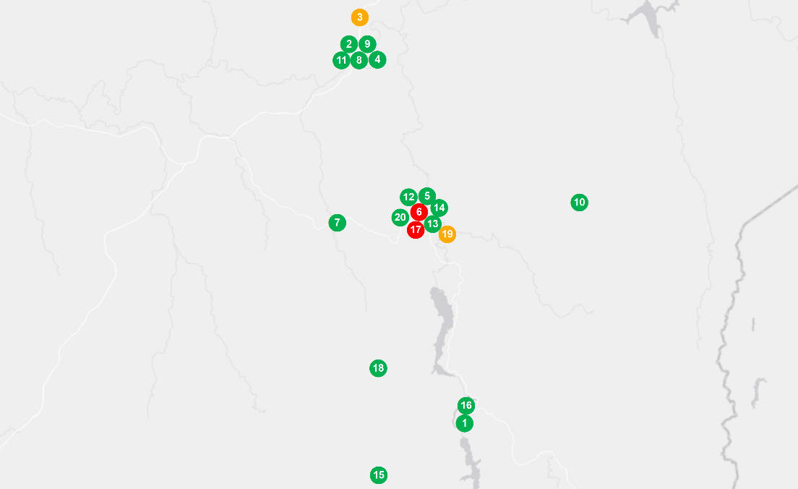
PROJECT DEVELOPMENT MAP 2024-2027₳
LEGEND
Commercial
Infrastructure
TUMUT
Industrial
Mixed-Use
Residential
# | Project£ | Type | Estimated Value^{µ} | Commence Date^{ψ}
1 | Talbingo Battery Energy Storage System (State Government) | Infrastructure | $500,000,000 | 28/12/2026
2 | Sheahan Bridge Upgrade (State Government) | Infrastructure | $20,000,000 | 2/11/2027
3 | Dog On The Tucker Box Gundagai Mixed Use Development (Restaurants/Hotels/Cabins/Landscaping/Conference) | Mixed Use | $14,623,450 | 20/09/2027
4 | Sheahan Bridge Klemmfix Safety Barriers Heavy Patching (State Government) | Infrastructure | $6,000,000 | 11/05/2027
5 | Tumut Aerodrome Upgrade (Local Government) | Infrastructure | $5,611,039 | 10/01/2025
6 | Lot 9 Fitzroy Street Dwellings (6 Dwellings) | Residential | $2,400,000 | 16/12/2024
7 | Snowy Mountain Highway Slopes Remediation (State Government) | Infrastructure | $1,693,739 | 16/01/2024
8 | Southwest Region Roadworks Microsurfacing Works (State Government) | Infrastructure | $1,000,000 | 2/03/2026
9 | Uralba Hostel Facility Renovation (State Government) | Infrastructure | $1,000,000 | 12/01/2026
10 | Brindabella Road Roadworks (Local Government) | Infrastructure | $1,000,000 | 25/12/2025
11 | Gundagai Old Sheahan Bridge Rehabilitation Works (State Government) | Infrastructure | $817,597 | 17/06/2024
12 | Wee Jasper Road Aviation Hangar (State Government) | Infrastructure | $800,000 | 12/01/2026
13 | 64 Fitzroy Street Office Space Refurbishment (State Government) | Infrastructure | $800,000 | 10/11/2025
14 | Tumut Region Sealed Road Patchworks & Sprayed Bituminous Surfaces (State Government) | Infrastructure | $800,000 | 2/01/2025
15 | Black Creek Road Storm Water Drainage Kerb Channels & Concrete Works (State Government) | Infrastructure | $750,000 | 12/01/2026
16 | Talbingo Transmission Track Road Embankments Stabilisation Works (State Government) | Infrastructure | $750,000 | 18/08/2025
17 | 140 Lambie Street Units (3 Units) | Residential | $750,000 | 1/11/2025
18 | Batlow Polices Residences (State Government) | Infrastructure | $726,660 | 11/03/2024
19 | Pretty Parrot Micro Distillery Little River (Distillery/Café) | Mixed Use | $700,000 | 23/07/2024
20 | Riverglade Oval Amenities & Storage Building (Local Government) | Infrastructure | $618,187 | 13/01/2025

Slide 5







Your home of the latest property market insights.
RESEARCH SERVICES
OUR KNOWLEDGE
Our research services span over every suburb, LGA, and state within Australia; captured in a variety of standard and customised products, and include:
Advisory and consultancy
Market analysis including profiling and trends
Primary qualitative and quantitative research
Demographic and target market analysis
Geographic information mapping
Project analysis including product and pricing recommendations
Rental and investment return analysis
Access to accurate and objective research is the foundation of all good property decisions.
OUR PEOPLE
Our research team is made up of highly qualified researchers who focus solely on property analysis.
Jed Masters
+61 417 274 977
jed.masters@prd.com.au
GET IN TOUCH WITH US TODAY
PRD Tumut
Your trusted local real estate agency
+61 2 6947 1722
sales@prdtumut.com.au
PRD.com.au/tumut/
2/81 Wynyard Street,
Tumut, NSW, 2720

Slide 6

REFERENCES
* Tumut sales market data and key indicators encapsulates aggregate property market conditions within the suburbs of Adelong, Batlow, Tumut, Gundagai and Talbingo.
** Estimated values are based on construction value provided by the relevant data authority and does not reflect commercial and/or re-sale value.
# 2025 encapsulates sales transactions for the 2026 full year (01/01/2026-30/06/2026).
€ Annual rental growth is a comparison between Q2 2025 (01/04/2025 – 30/06/2025) and Q2 2026 (01/04/2026 – 30/06/2026) house median rent figures.
¥ Tumut rental market data encapsulates aggregate property conditions within the postcode of 2720.
§ Rental yields shown are as reported as of June 2026.
₳ Project development map showcases a sample of upcoming projects only, due to accuracy of addresses provided by the data provider for geocoding purposes.
£ Projects refers to the top developments within the suburb of Adelong, Batlow, Tumut, Gundagai and Talbingo.
µ Estimated value is the value of construction costs provided by relevant data authority, it does not reflect the project’s sale/commercial value.
ψ Commencement date quoted for each project is an approximate only, as provided by the relevant data authority, PRD does not hold any liability to the exact date.
Source: APM Pricefinder, Cordell Connect database, SQM Research, Esri ArcGIS.
Disclaimer: PRD does not give any warranty in relation to the accuracy of the information contained in this report. If you intend to rely upon the information contained herein, you must take note that the information, figures and projections have been provided by various sources and have not been verified by us. We have no belief one way or the other in relation to the accuracy of such information, figures and projections. PRD will not be liable for any loss or damage resulting from any statement, figure, calculation or any other information that you rely upon that is contained in the material.
Prepared by PRD Research. © All medians and volumes are calculated by PRD Research. Use with written permission only. All other responsibilities disclaimed. © Copyright PRD 2025.

